Slide 1
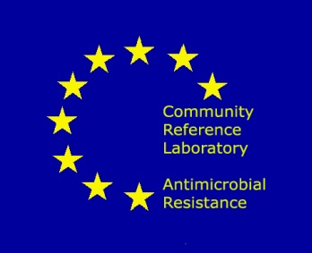


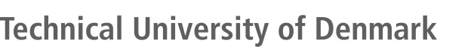
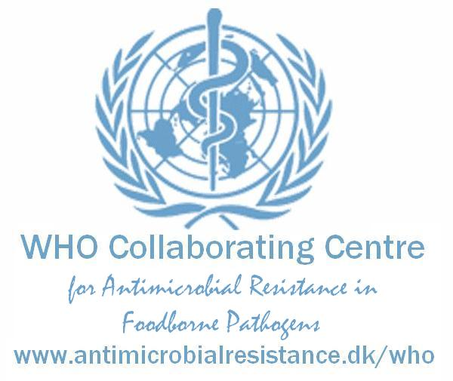
Global Genomic Epidemiology Data sharing
Frank M. Aarestrup
www.compare-europe.eu
www.veo-europe.eu
www.genomicepidemiology.org
www.globalsurveillance.eu

Slide 2
Infectious diseases is one of our greatest health issues
A very large range of pathogens
Silent epidemics (AMR, E. coli, Staphylococcus)
Outbreaks (Salmonella, cholera, listeria)
Pandemics (influenza, corona, cholera) – COVID-19 is only one of many
Major consequences
Morbidity, mortality, economic
In all cases global surveillance and datasharing is essential

Slide 3
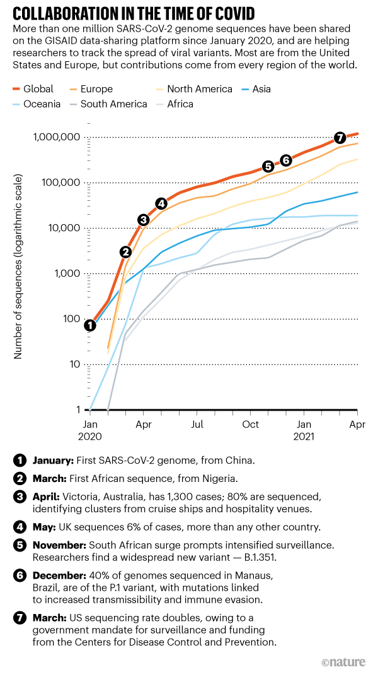
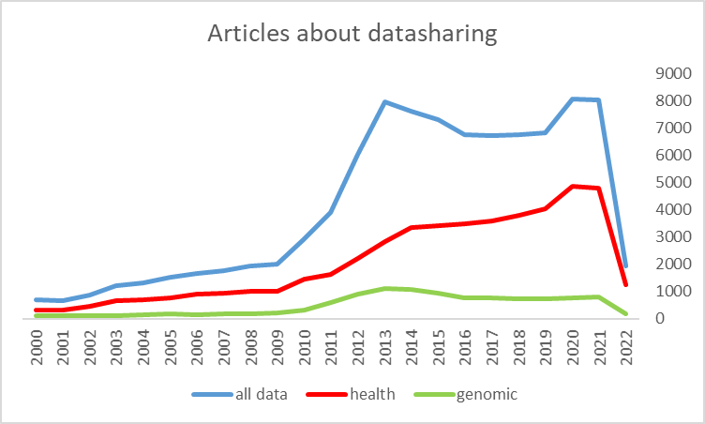
Data sharing is a big issue

Slide 4
Why share data?

Slide 5
Why share data
Detection of outbreaks
Research
Surveillance
Development of:
Diagnostics
Vaccines
Treatment

Slide 6
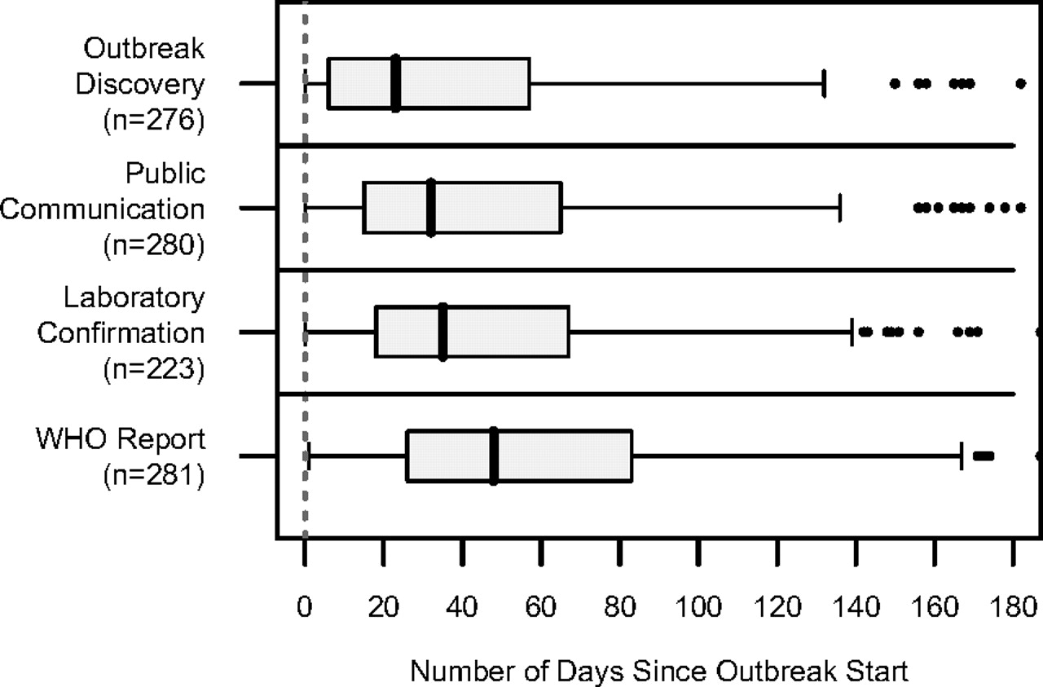
Box plots of the median time between estimated outbreak start and various outbreak milestones for a subset of WHO-confirmed outbreaks, 1996–2009.
Emily H. Chan et al. PNAS 2010;107:21701-21706
Notes:
Box plots of the median time between estimated outbreak start and various outbreak milestones for a subset of WHO-confirmed outbreaks, 1996–2009. Public communication refers to the earliest date of the public being informed about the existence of cases. WHO report refers to the date of WHO's Disease Outbreak News report about the outbreak. Some extreme outliers are not shown. n, sample size.

Slide 7
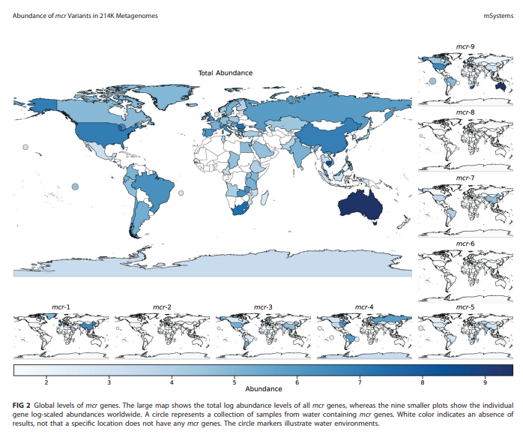
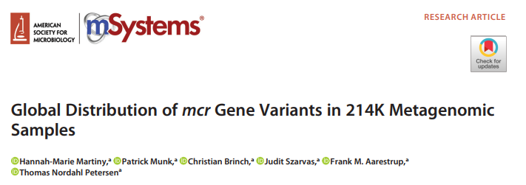
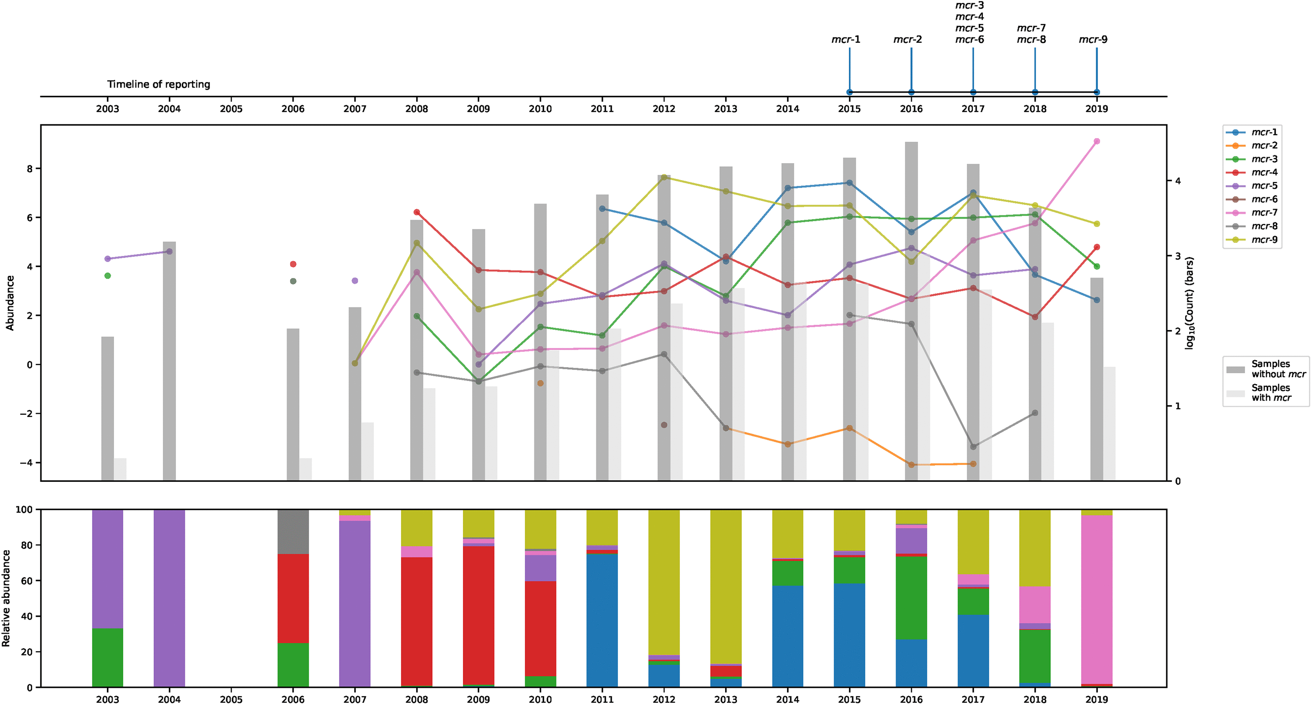
214,095 samples – 442 Tb data – Sharing raw reads might allow for later exploring something previously unknown

Slide 8
The sharing of GSD during epidemics: Immediate and long-term response capacity
Only by using SARS-CoV sequences available in GenBank, and stored SARS clinical samples for evaluation, a RT-PCR test SARS-CoV-2 specific was developed even before the first sequences were shared
Notes:
The sharing of pathogen genetic resources (defined as both biosamples and GSD) support not only the immediate response to current outbreaks but also build long-term capacity for rapidly responding to future threats.
In this study, published by scientists from the Charité in Berlin, a diagnostic workflow for screening and specific confirmation of SARS-CoV-2 was developed within 9 days from the first rumors about the new virus (indicating it was some variety of CoV); published (in the WHO website) within 15 days; and validated through the EVDlab net within 22 days. The assay was designed in absence of available virus isolates or original patient specimens, and even before the first viral sequence was shared.
Design and validation of this assay were enabled by the close genetic relatedness to the 2003 SARS-CoV, SARS-CoV sequences available in GenBank, and stored SARS clinical samples for evaluation; through the use of synthetic biology.
Just for the sake of comparison: for MERS the time-frame for diagnostic development and publication was 2 months after the hospitalization of P0. And as showed in the first slides, sharing samples for diagnostic validation for ZIKA took over 1 year.
This impressive timeline was only possible due to SARS samples and sequences available through depositing structures such as biobanks and databases that mantain a collection of pathogen biodiversity, besides of course an efficient collaboration in an informal network of high ranking laboratories. Therefore, populating biobanks and databases represents a huge collective value to build infrastructures to support long term response to newly emerging IDs threats.

Slide 9
Which data should be shared?
Genomic information
Raw data or assemblies?
Epidemiological information
How detailed (GDPR)

Slide 10



Why are raw data important? - SARS-CoV-2 are often mixed infections
Concensus is only pigs
1 cow and 3 pigs

Slide 11
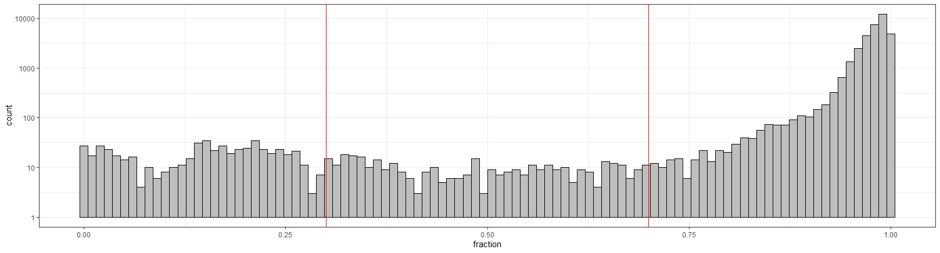
Number of variants at non-consensus level (at 70% cutoff >30x coverage)
Minor variant
Ambiguous variant
Consensus variant
<=0.3: 551
>0.3&<=0.7: 367
>0.7: 35,251
1,754 Nanopore amplicon sequenced samples
Total variants: 35,994 (from Wuhan reference)

Slide 12
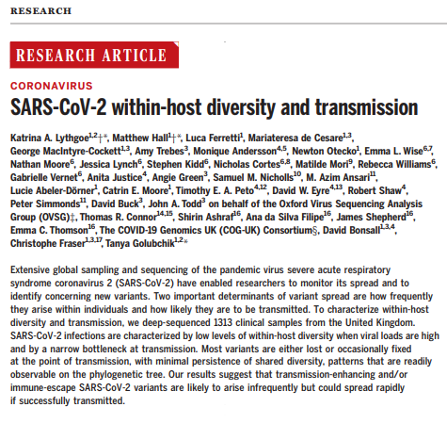
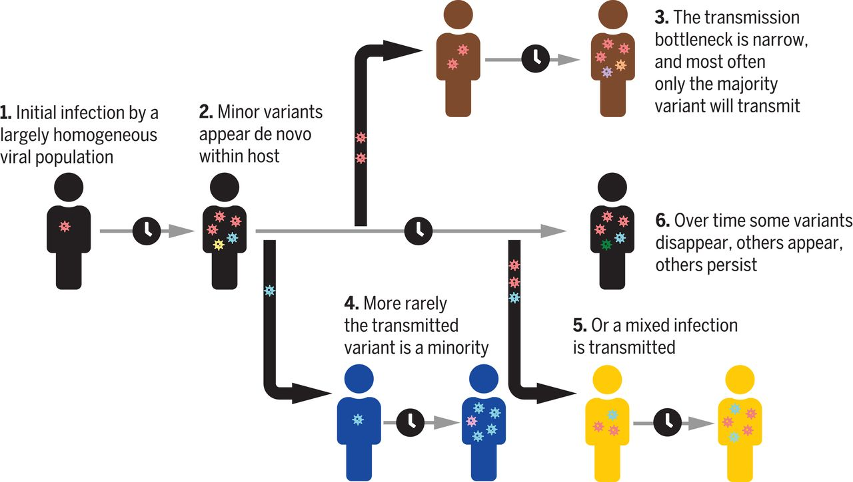

Slide 13
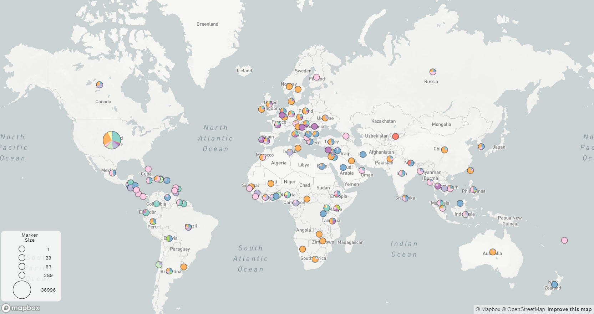
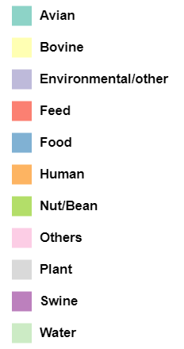
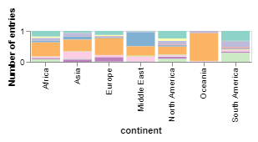
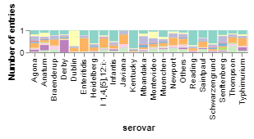
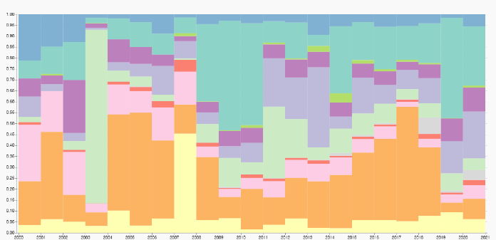
Figure 1 The global distribution of Salmonella enterica in different isolation sources divided by continent, serovar and year
BUT only epi-data for 47,425 (25%) out of 191,306 isolates
Nuanmuang et al.
Notes:
Note : Time scale showed 2000 -2020

Slide 14
Benefits of data sharing
Several benefits
Rapid outbreak detection
Development of vaccines and diagnostic tests
Surveillance
Novel research
Raw sequence data can be valuable
Sufficient epidemiological information is essential
There can be no real-time surveillance without real-time data sharing

Slide 15
Arguments against sharing

Slide 16
Arguments against sharing
Benefit the rich
Benefit those who can do rapid research
Other concerns:
Ethical
Administrative
Political

Slide 17
Ethical
Person (or company) identifiable
Can a microbiome be person identifiable?

Slide 18
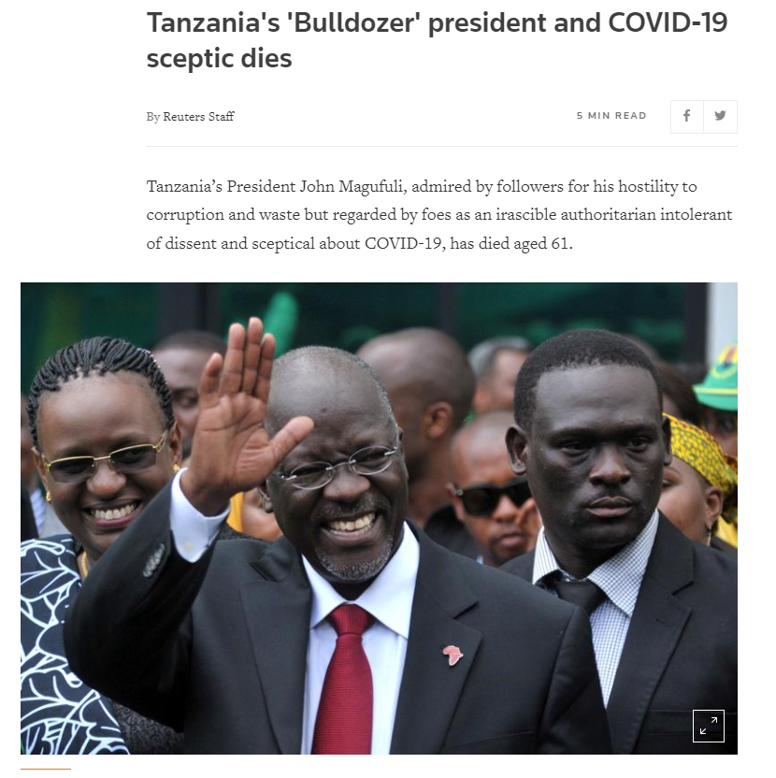
Political
Concerns regarding:
Tourism
National development
Status

Slide 19
Administrative / practical
It takes time to share
IT-connections and knowledge / expertise
Concerns about doing something wrong

Slide 20
Legally
National legislation
GDPR
Nagoya protocol

Slide 21
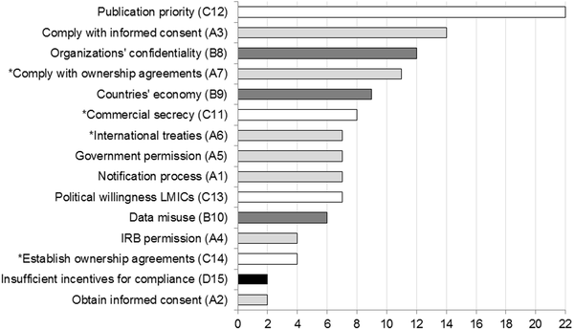
Fig 9. Publication priority was the most frequently mentioned barrier.
Ribeiro CdS, van Roode MY, Haringhuizen GB, Koopmans MP, Claassen E, et al. (2018) How ownership rights over microorganisms affect infectious disease control and innovation: A root-cause analysis of barriers to data sharing as experienced by key stakeholders. PLOS ONE 13(5): e0195885. https://doi.org/10.1371/journal.pone.0195885
https://journals.plos.org/plosone/article?id=10.1371/journal.pone.0195885

Slide 22
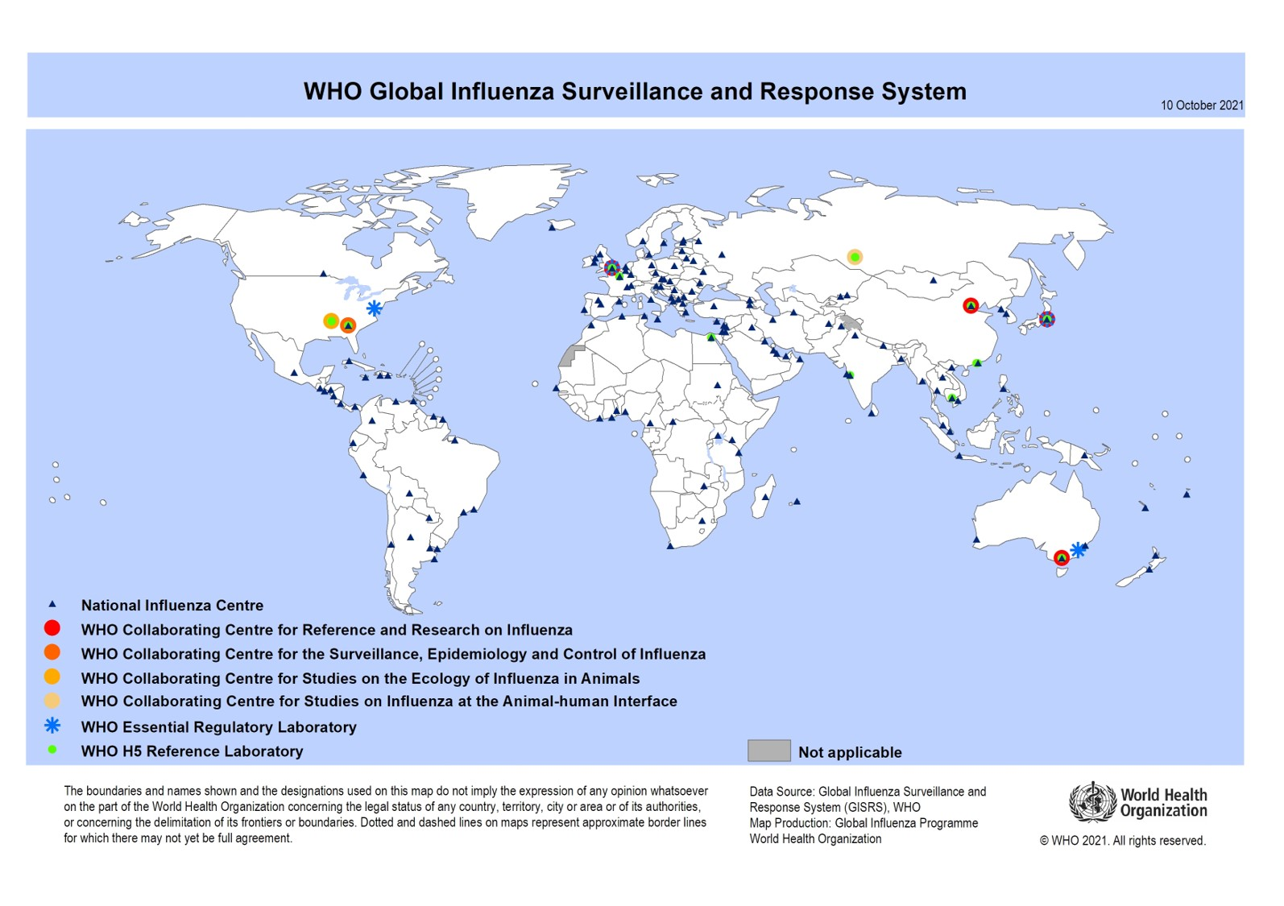
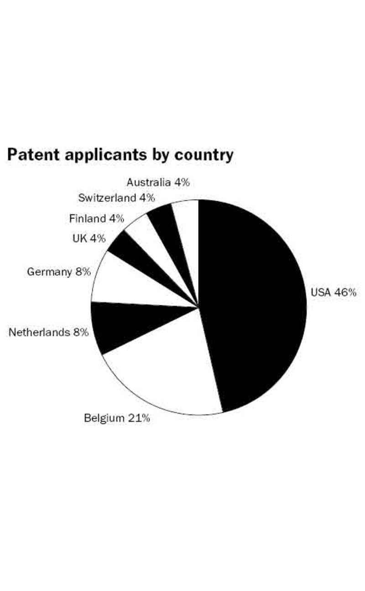
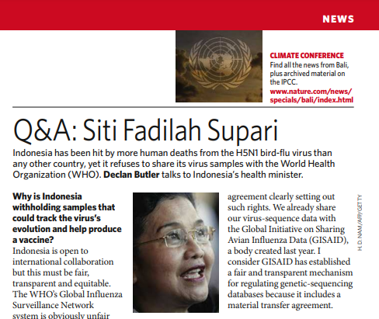
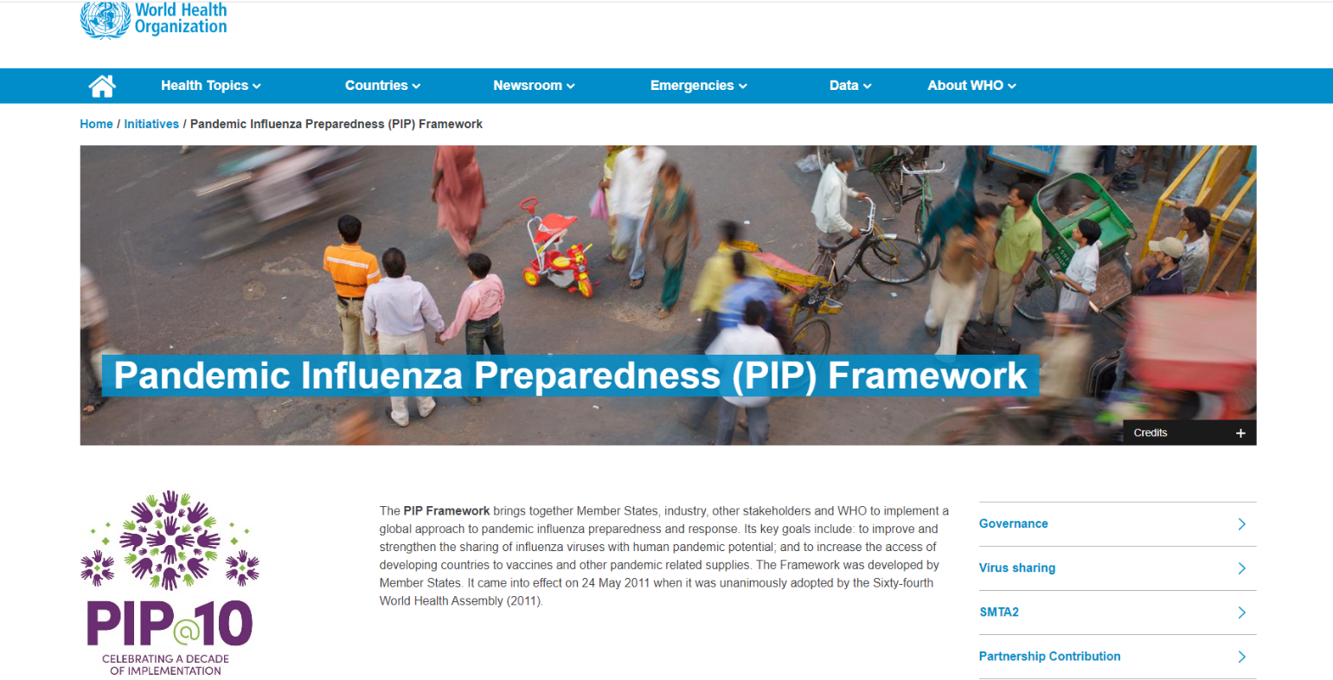

The flu story
Data collection for influenza since 1945
Increased concerns about mutual benefit
In 2007 the Indonesian minister of health asked for access to vaccines
Where answered no
Decided not to share
Novel PIP Framework with mutual benefit
More closed data sharing

Slide 23
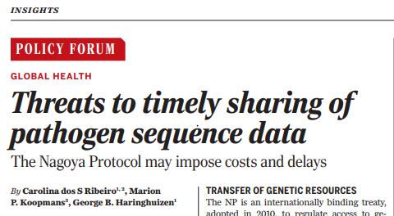
The Nagoya protocol
Protects natural resources of the country of origin
Agreements should be in place before natural resources are utilized
Major fines
However, what does it cover?
Physical samples?
Genomic data?

Slide 24
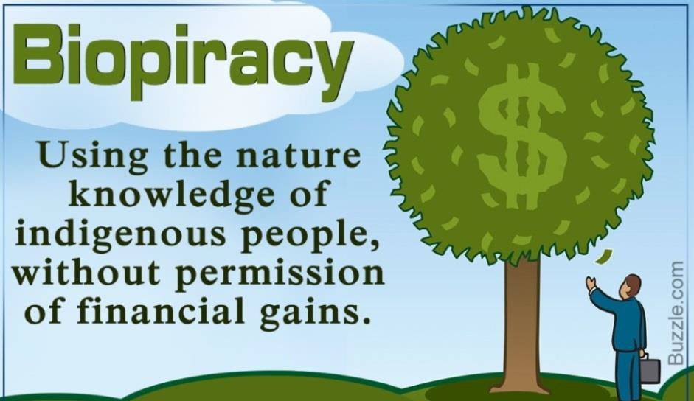
Why the Nagoya Protocol was developed?
The environmental problem
Unsustainable global economy: natural resources depletion; environmental degradation; extinction of species; climate change; water shortage
More frequent natural disasters and global health threats
Perception that conservation areas equal economic losses
The social problem
Besides the social impact of environmental degradation: poverty, immigration, disease
Threats and exploitation of indigenous people as custodians of biodiversity
The global political problem
Heritage from colonization process
Appropriation of biodiversity through patents
Inequalities in benefiting from biotech research and development

Slide 25


How the Nagoya Protocol was adopted?
Polarization between developed and developing countries
The Indonesian case on the sharing of influenza strains at the WHO’s GIS
No benefit sharing, no access!
Results: the NP, the ITPGRFA, and the PIP Framework

Slide 26

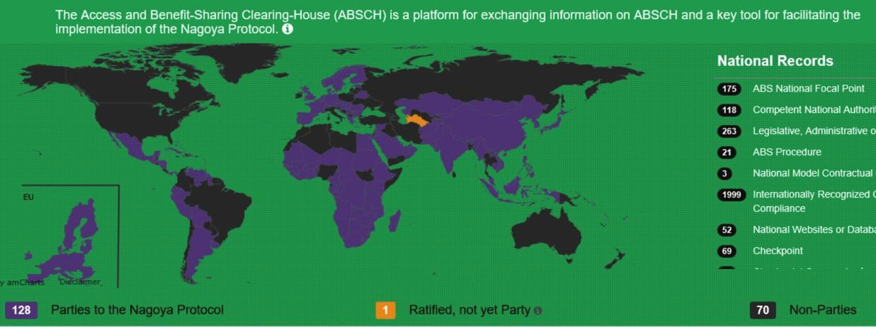
Identifying Parties
There are non-Nagoya Parties that have ABS regulations
Discovering ABS regulations (ABSCH and NFP)
There are Nagoya Parties that have not yet ratified
Understanding ABS regulations and acquiring permits (NFP)
*https://absch.cbd.int/

Slide 27

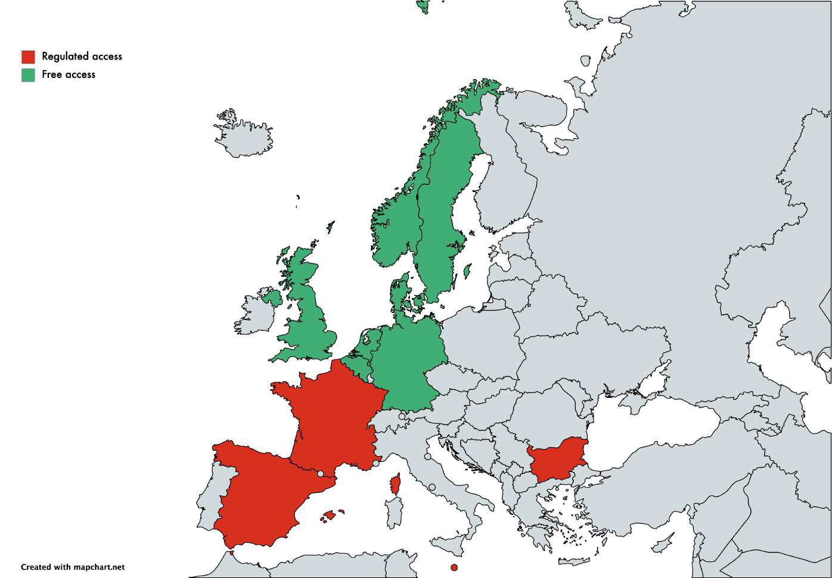

Diverse National Jurisdiction
Sovereign rights: each country can decide IF and HOW they regulate their resources
EU countries that regulate ABS to GRs: Spain, France, Croatia, Malta and Bulgaria
Negotiating permits and contracts bilaterally (NFP)

Slide 28

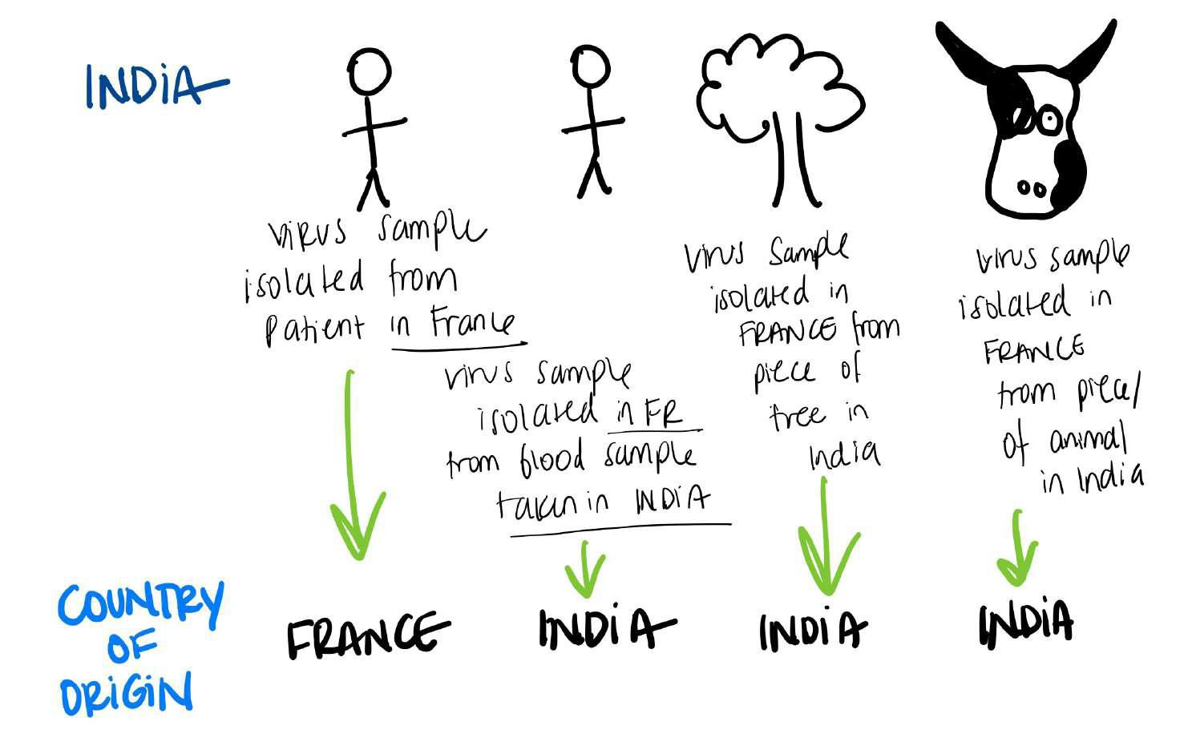
Country of origin

Slide 29
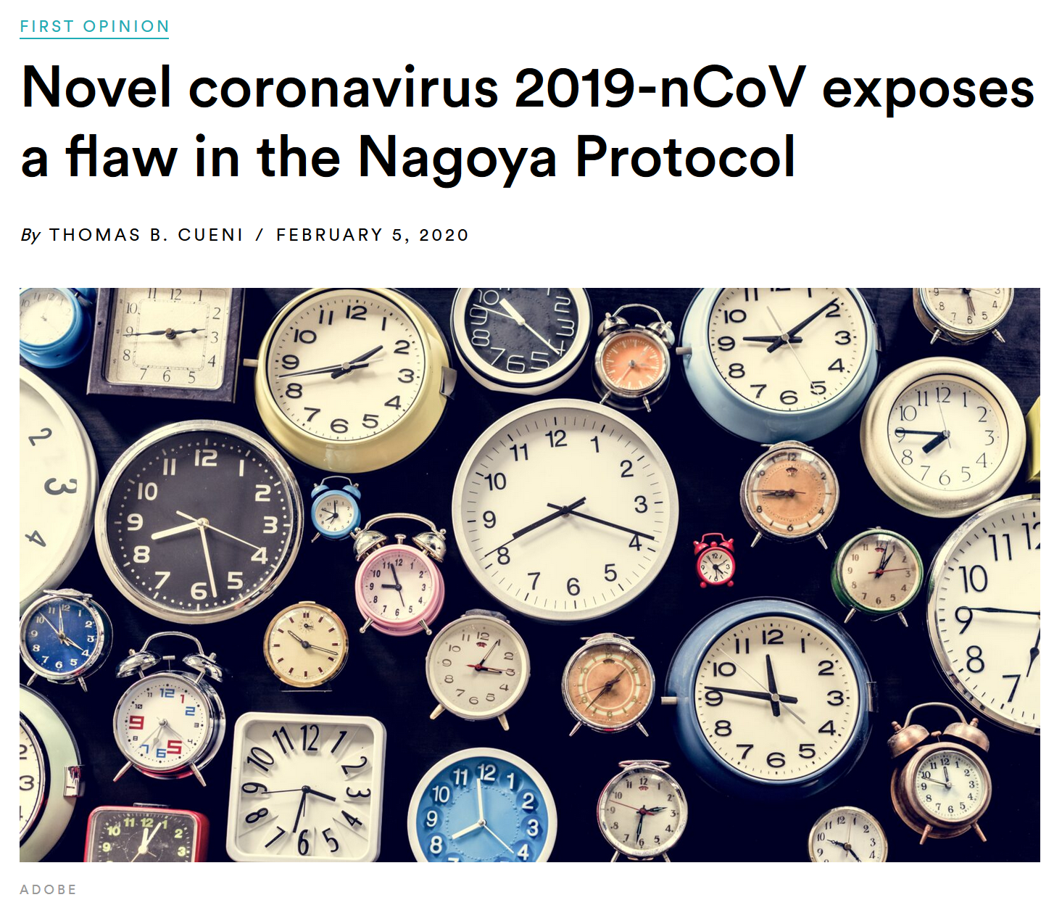
Uncertainties for sharing pathogen genetic resources during epidemics
A way around the Nagoya Protocol?
An interconnected world with pathogens that know no borders
It is just a matter of time!
Genetic sequence data (GSD)is making access to viral isolates unnecessary
Will the COVID-19 case be used as an argument for including GSD in the scope of the Protocol?
References labs all over the world support diagnostic capacity
EU Regulation 3 months exemption
What to do with the stored diagnostic samples after that?
Will countries in the future claim Nagoya rights?
Notes:
The NP, that many of you probably by now heard about, is an international treaty adopted under the umbrella of the UN environmental agency of the Convention on Biological Diversity, and creates a framework to regulate global sharing of non-human genetic resources, in which pathogens are included.
This protocol reinforces 2 principles of:
sovereign rights, by establishing that countries can decide and regulate how genetic resources in their territory are access and the conditions under which they can be used;
This establish the principles of reciprocity and fair collaborations on the sharing of genetic resources by giving the provider countries the right to ask for a share on benefits either on a monetary or non-monetary basis, out of the foreign use of their resources.
During the COVID-19 pandemic, some flaws in the NP framework were exposed:
The first reason is a natural one (reflecting the nature of IDs): within a PHEIC pathogens respect no borders so it is just a matter of time that countries start having infections and therefore can access pathogen materials within their own borders of from neighboring countries
The second reason is a technological one: with the recent developments in biotechnology GSD is making the access to biological material obsolete, as demonstrated for the diagnostics development in the previous slide.
One fear of many in the global health field is that this will be used as an argument within the discussions of the CoP to the NP/CBD to include GSD within the scope of the Protocol. Although this looks at the moment as the most probable outcome of the political negotiations later this year, the COVID-19 case also give us important arguments for why the sharing of GSD form emerging pathogens as early and open as possible cannot be hampered, and this should be protected at all costs.
Finally, many labs all over the world are cooperating to support global diagnostic capacity. The EU Nagoya-Regulation, established a 3 months exemption, in which during a PHEIC countries can access pathogen materials from Nagoya-countries without the required documentation and agreements, but after the 3 months they have to acquire those retrospectively.
Now, that the 3 exemption months have passed, many labs are uncertain of how they should proceed, and wonder how to handle these obligations in such a chaotic and busy environment, still trying to control the pandemic.
The NP has not being extensively mentioned in the COVID-19 discussions so far, but a triggering question is whether in the future, by evaluating the response to the pandemic, countries and institutes will heavily be criticized, and even sued, for not complying with presumed NP regulations.

Slide 30
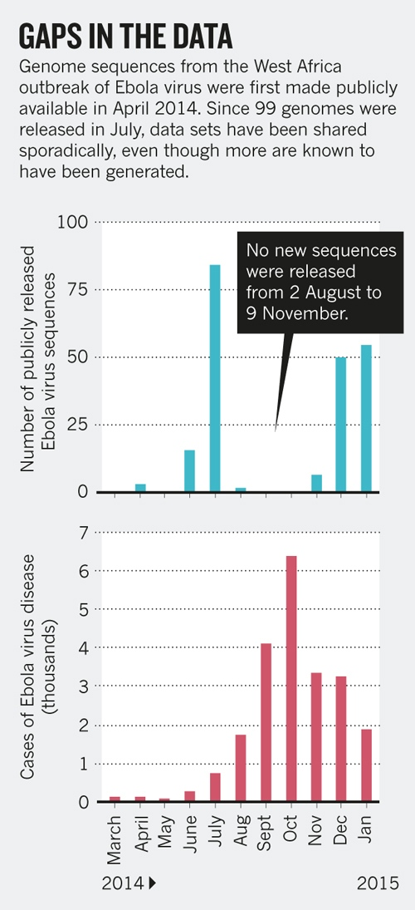

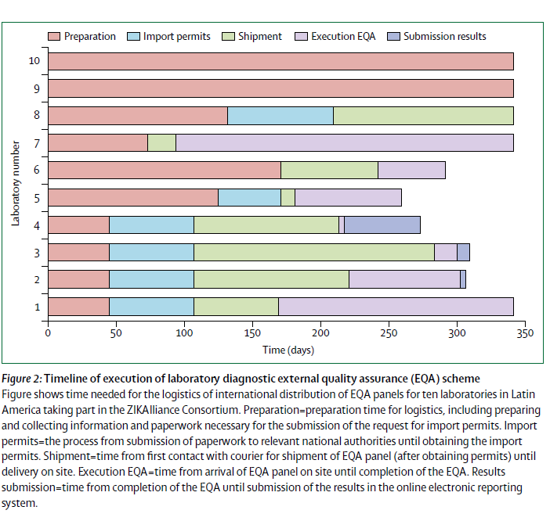
Barriers: Experiences during past epidemics
from
Middle East Respiratory Syndrome
*Kiss of death: Defiant farmers still smooching CAMELS despite deadly virus warnings. Mirror News. 2014
through
Ebola
,
ZIKA
to…
*Yozwiak NL, Schaffner SF, Sabeti PC. Data sharing: Make outbreak research open access. Nature. 2015;518(7540):477.
*Koopmans, M., de Lamballerie, X., Jaenisch, T., Rosenberger, K. D., Morales, I., Marques, E. T., ... & Segurado, A. (2018). Familiar barriers still unresolved—a perspective on the Zika virus outbreak research response. The Lancet Infectious Diseases.
Notes:
I will start with some examples from past epidemics: What we have seen is that during the last global health crises we faced, at least the ones caused by emerging IDs, there have been substantial challenges of different nature for collaboration and data sharing affecting the national and international response efforts
A lack of integrated actions between human and animals domains and the exercise of presumed sovereign rights of a country’s government – as in de case of Mers-CoV
Further: Inconsistent sharing of genome sequences leading to unnecessary delays in control measures (as clearly shown by Yozwiak et al) and the storage of thousands of isolates behind lock and bar in foreign countries, unreachable for scientists in the originating countries – as in the case of the 2016 West African Ebola outbreak;
And finally: the 2015 ZIKA epidemic in Latin America clearly illustrated issues with government (regulatory) restrictions on the international sharing of materials, compromising greatly the rapid development of high quality and validated diagnostic tests. Koopmans et al. have shown the irresponsible delays, leading to the sad lack of precise diagnostics for pregnant women having to decide on following on with their pregnancy.

Slide 31
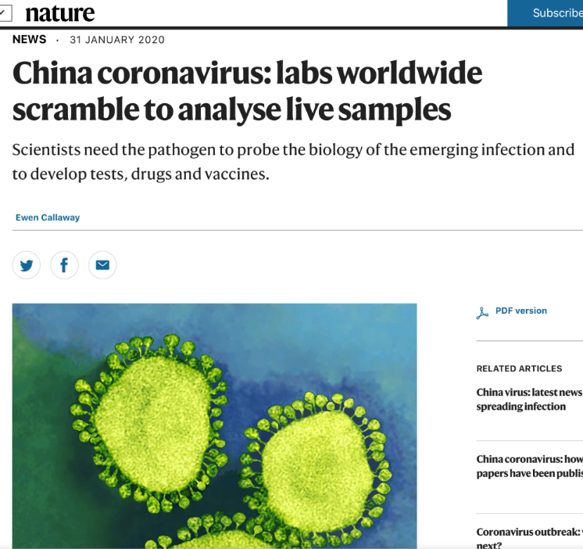
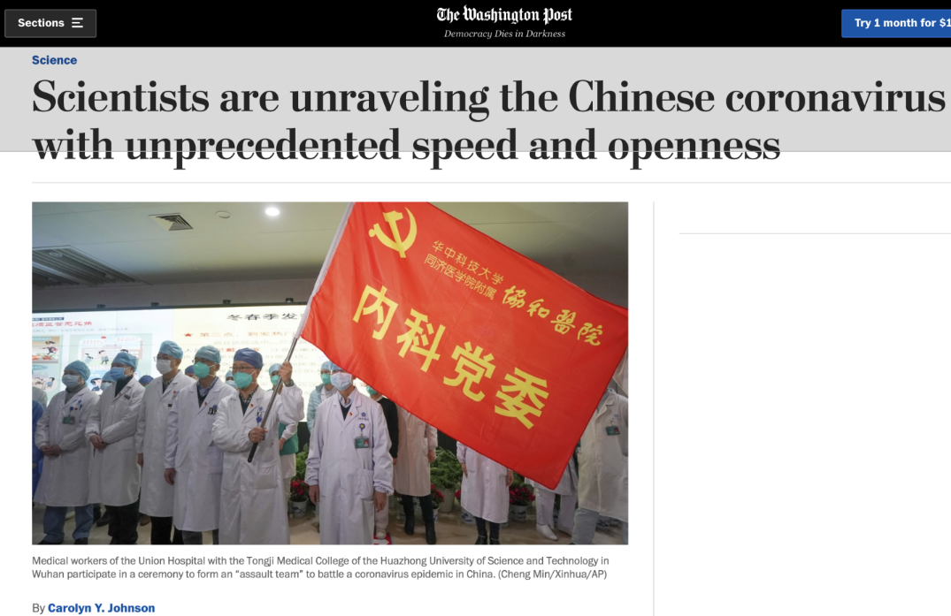
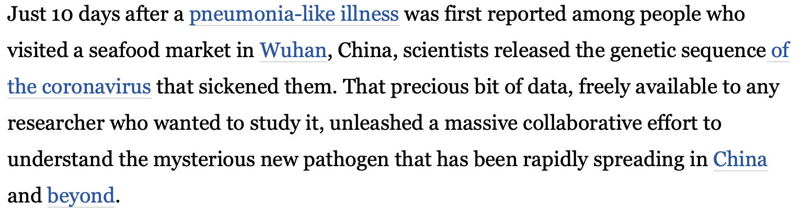
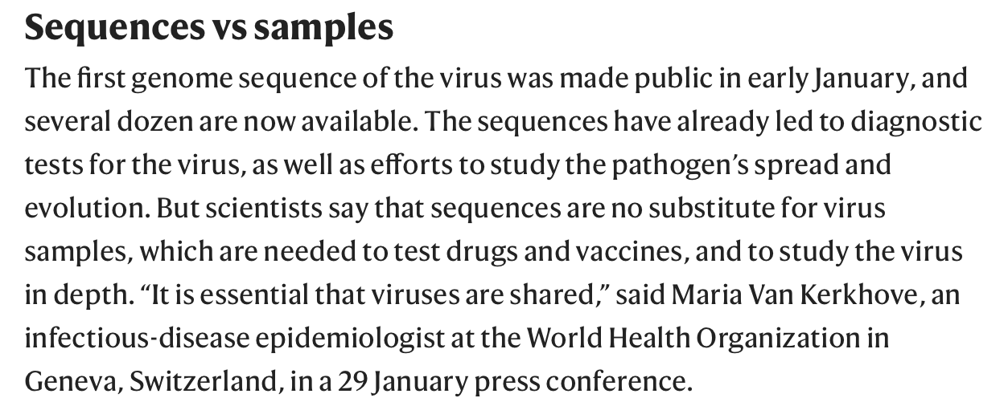
Barriers: Experiences from current pandemic
COVID-19
Access to samples and data…
…VS the sharing of resulting benefits
*THE GARDIAN
Notes:
Now, during the COVID pandemic we have been witnessing the clear polarization between the two sides of sharing during epidemics.
On the one hand many struggle to access samples and data in order to engage/initiate R&D:
Although in this pandemic the GSD of the SARS-CoV-2 was shared publicly with reasonable speed, though presumably – as we now recently understand – thanks to the brave solo action of 2 individual scientists …
…. the sharing of the viral samples and materials did not follow the same path. Labs worldwide struggled to get samples from the from the first affected countries.
- On the other hand, international communities, especially from LMIC, are concerned on historical grounds about the sharing of the benefits resulting from the R&D process
As illustrated by this letter singed by NGOs all over the world urging the UN and WHO to develop actionable and binding mechanisms to guarantee that potential drugs and vaccines developed against COVID-19 are shared with the whole world in equal and affordable terms, as well as technology and research results/outcomes.
Many might think that the latter is unreasonable and political: high-tech public-private consortia in an open market are the natural way in which things happen during such a devastating pandemic. But in reality their concern might after all very well appear not to be unfounded.

Slide 32

Barriers: Experiences beyond epidemics
Febr. 6 2019
Emmanual Freudenthal with a grant from the European Journalism Center
Ebola's lost blood: row over samples flown out of Africa as 'big pharma' set to cash in
A row is simmering over the ownership of thousands of Ebola blood samples taken from patients during the 2014-16 epidemic in West Africa and now held in secretive laboratories around the world. African scientists and Ebola survivors accuse the laboratories of biological asset stripping and want their samples back for research.
Among the Ebola patients (2014-2016) whose blood was exported without consent is a woman from Guinea whose sample is anonymised under the code C15. She does not know that the Ebola virus isolated from her blood is advertised on the website of the European Virus Archive*, for sale by [ Laboratory X ] at a price of €3637,38 for 0.5ml. That is 170 times the price of gold.
The German lab said they isolated the virus at the time and sent it around to many institutions around the world. The C15 sample was pre-Nagoya (2014) and the virus was extracted, characterized and purified by [ X ]. This gives under EU laws IP rights to the laboratory to offer it on the market which they did against cost-price.
During an outbreak colleagues are 24/7 busy in the response process lost access and control over the collected materials/data is the issue
Notes:
But this is not all. Because on top of that, issues in data sharing also extend beyond epidemics’ timelines. I will start with just an example:
- In Feb 2019 the telegraph published an article describing the case of samples taken from Ebola patients and stored at a German lab that was made available through the platform of the virtual collection of the EVA, for a price quoted ”170 times the price of gold”.
When questioned about the fact the German lab defended their position by saying that the virus at the time was shared freely with many labs worldwide and they provided their service to make it a high quality sample made available at cost prices to all potential users.
But a fact is that during outbreaks local researchers, especially from LMIC are usually busy helping out in the response; and on the grounds that they do not have storage facilities for biological materials (as biobanking capacity) they end up losing access to materials and data in the long run being unable to further engage in research efforts.

Slide 33
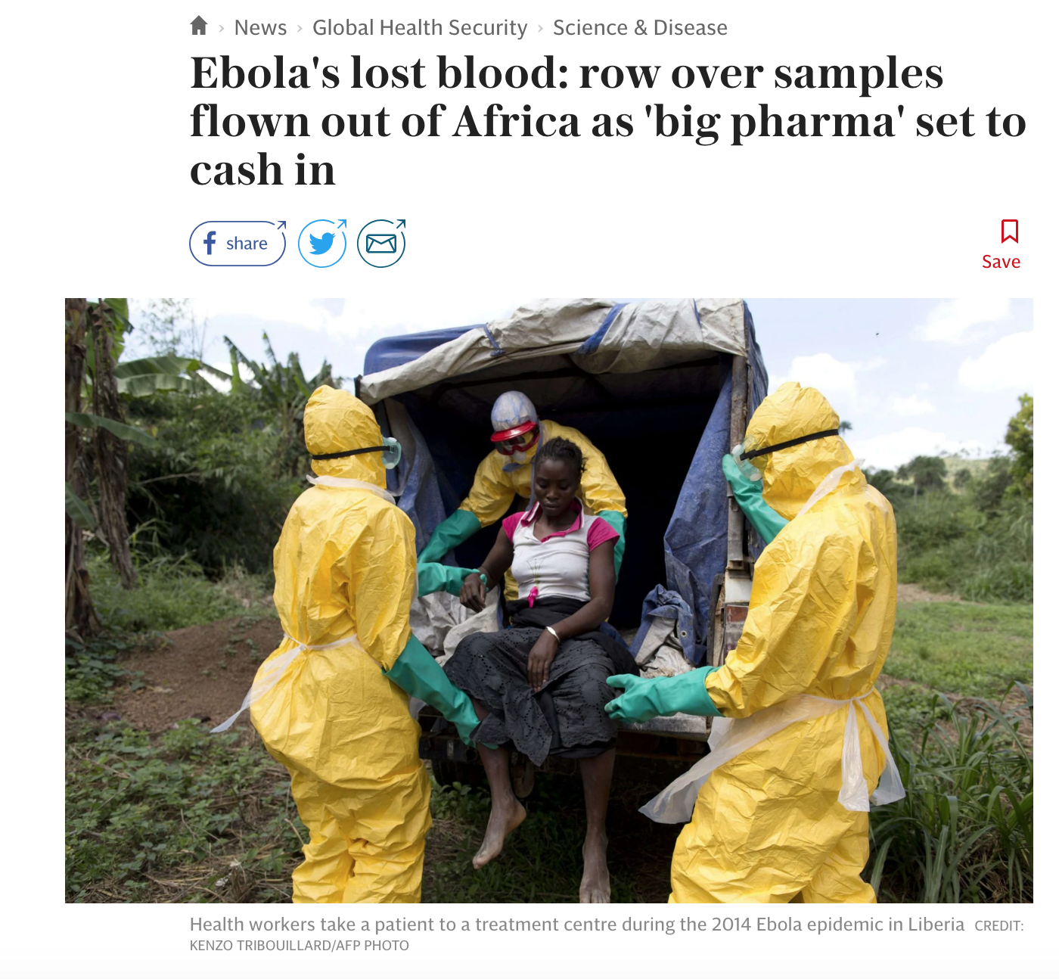

Slide 34
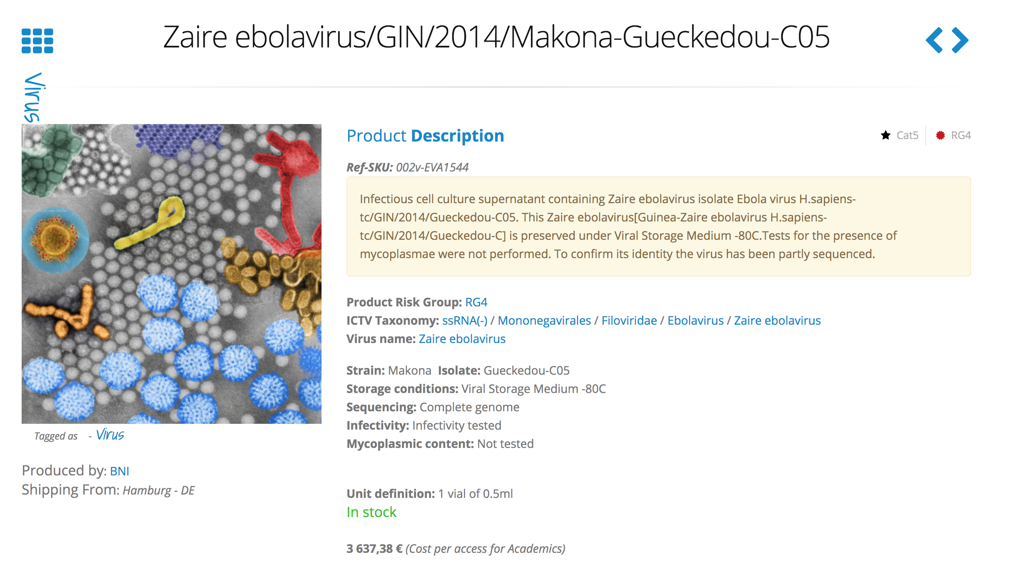

Slide 35
Data sharing models
Raw genomic data
Assemblies
Summary data

Slide 36
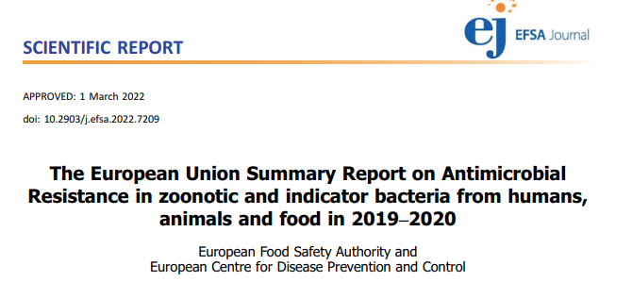
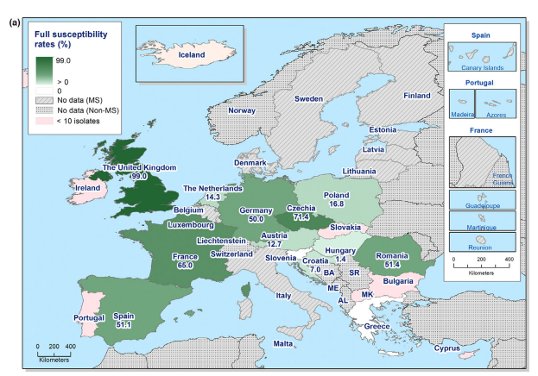
Summary

Slide 37


Genomic data
Raw data
Created for human genomics
For bioinformaticians
All life
Created for virus
For virologists
Selected pathogens
assemblies

Slide 38
Our modest contribution
Pre-competitive and enable, Not decide or dictate
(not parachute scientists)
Global freely available online bioinformatics (since 2009)
Facilitating local small-scale analyses (since 2021)
3 MOOCs and bringing DTU courses from 5 to 50 ECTS within infectious diseases during 2009 - 2022

Slide 39
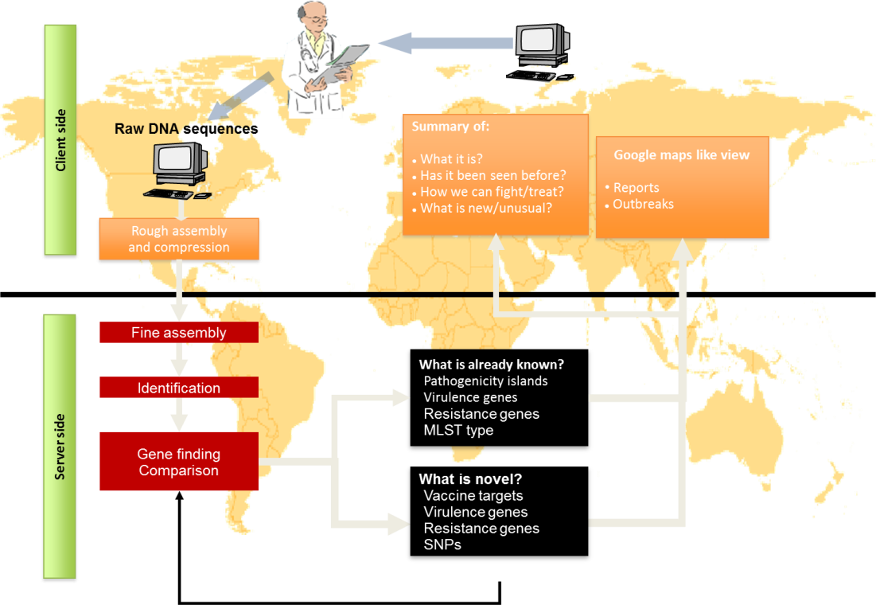
2009 – Online bioinformatics
Needs /possibilities
More rapid response on global infectious disease
transmission and sharing of data
Potential solution
NGS is a common language and easily shared
But complicated and BIG data
Research
Provide online bioinformatics solutions

Slide 40

Traditionel – top-down
Decide on a problem
Identify or establish reference centres
Get isolates/data from local frontline

Slide 41
Open science
Allow storage and analyses for all at a central facility
Also facilitating sharing with others and not only pre-defined problems

Slide 42
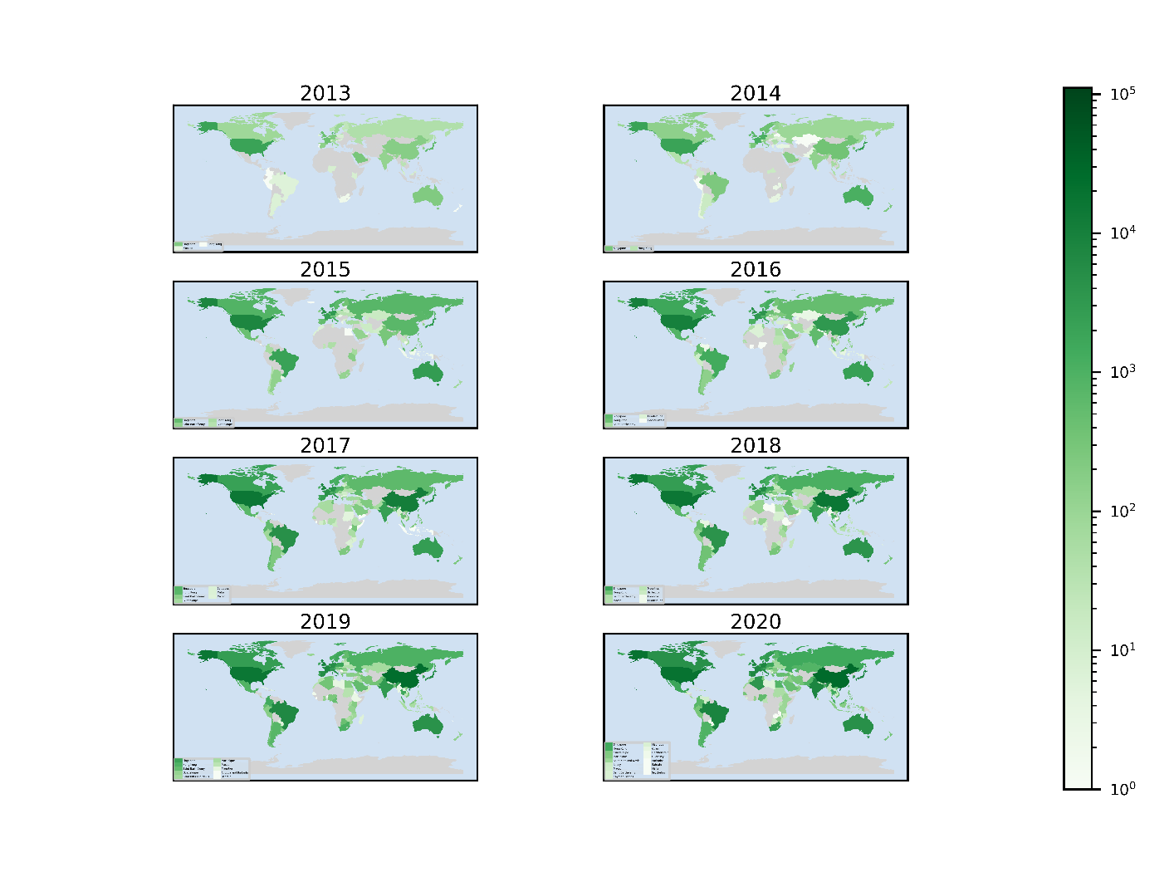
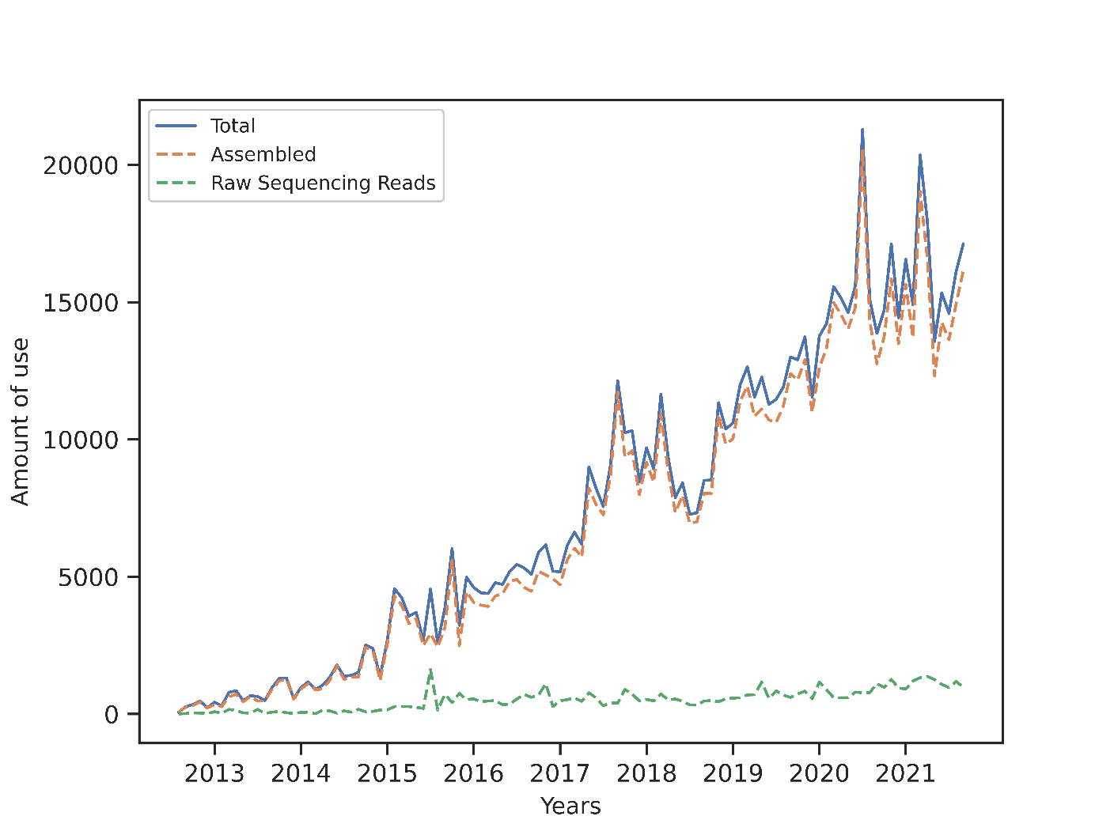
Current use just for AMR is around 15,000 analyses per month and LMICs have started to become visible

Slide 43
The bottom-up approach – going totally frontline
Provide really simple tools
Allow creation of local sharing
Enforce entering of metadata so it can be shared

Slide 44
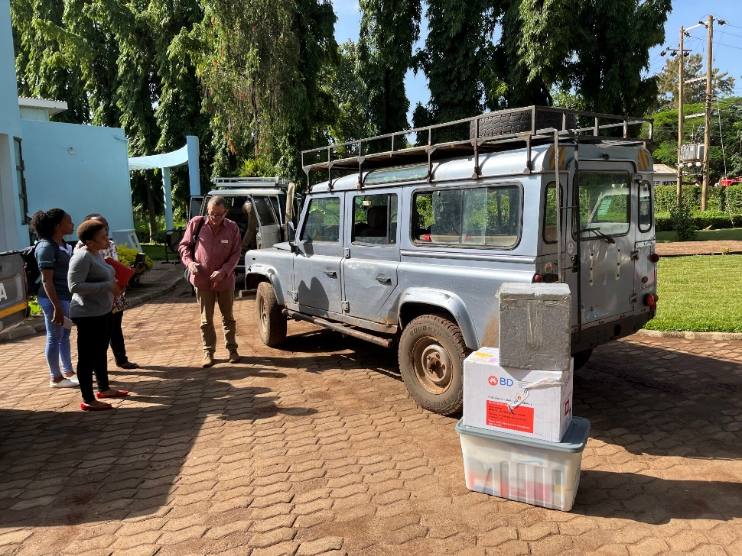
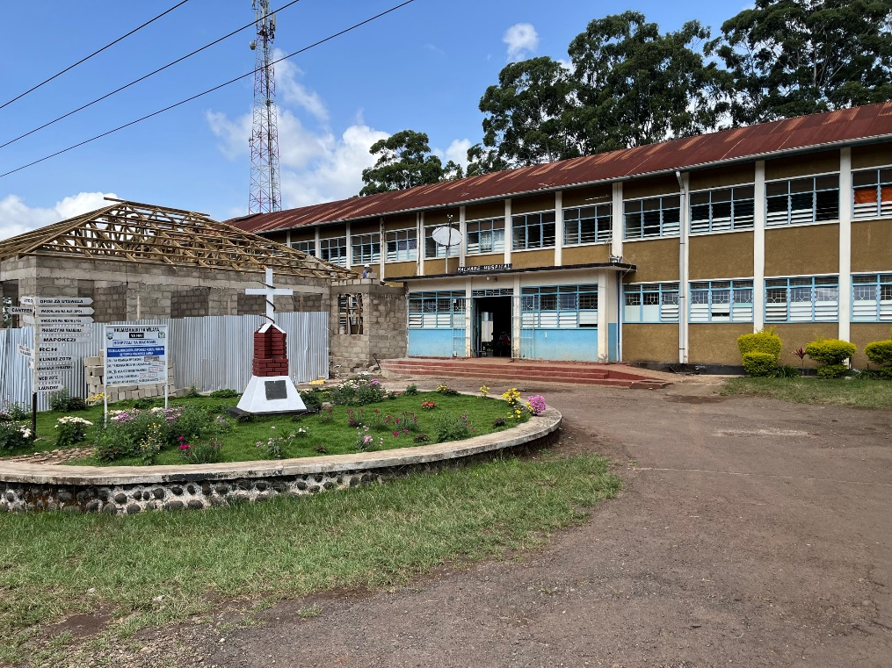
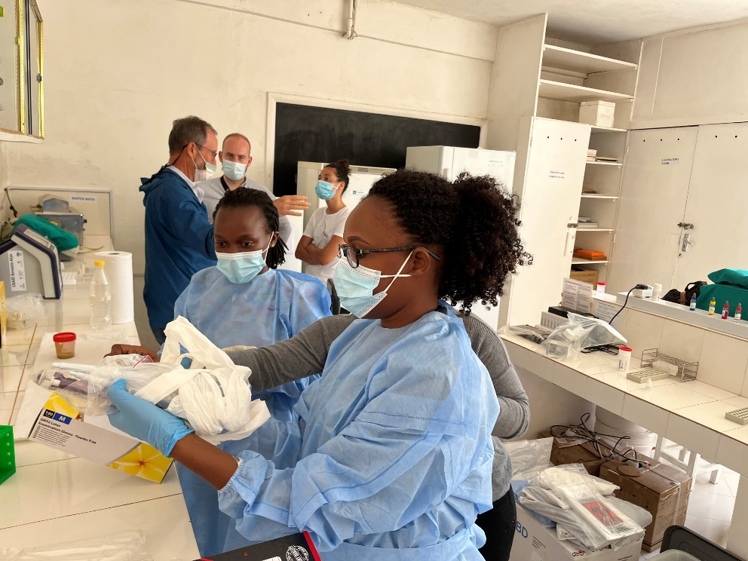
Just back from Tanzania
Child with diarrhoea -> campylobacter -> treatment adjusted
Worked on water, faeces and other samples
Lap-top with no internet or HPC

Slide 45
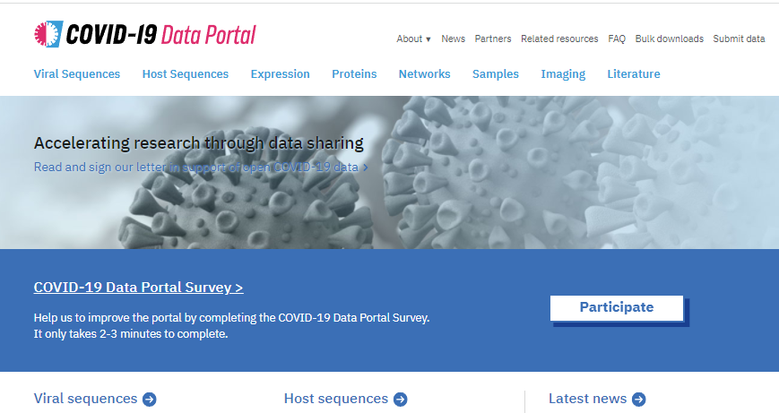

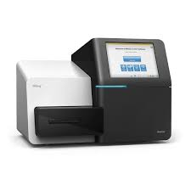
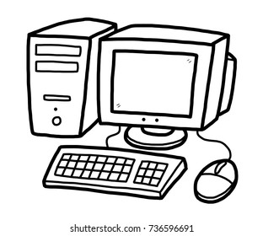
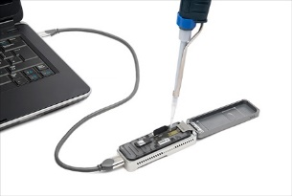
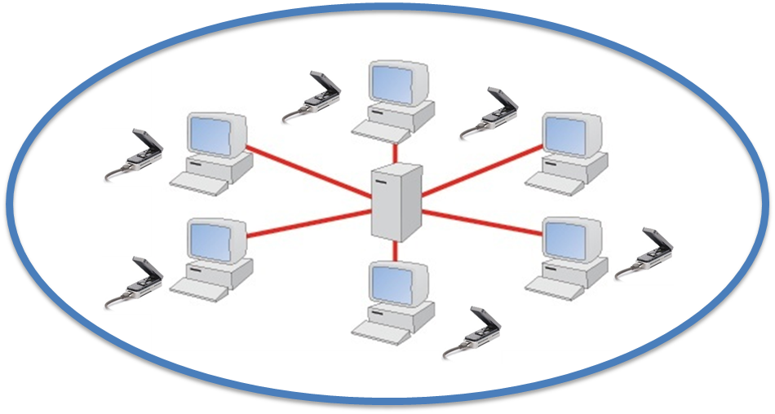
Dissecting genomic surveillance
Data-sharing
Public repositories
Datahubs
Drop-box
Online services
ResFinder
Isolation, Sequencing, Analyses
Isolation, Sequencing
Favours those who have
Enable some
Enable more
But require novel coding
Proven extremely difficult
Facebook for Genomics

Slide 46

Summary
Enable not dictate
Data sharing has many benefits, but also some issues
Important for you to be aware

